Slide 1
Semi-Annual Behavioral Health Stakeholders Convening
Magellan in Louisiana: Transforming our System 04.17.13

Slide 2

Getting started – A year of transition
Pre 3/1
Build the infrastructure
Train and engage
3/1
Turn on the lights
Answer the phones
3/1- Now
Address challenges that come with large-scale change
Refine the program
Ensure continuity of care (Priority No. 1)
Learn the nuances; adjust as needed
Train and teach and train some more
Build the network

Slide 3
Before the Louisiana Behavioral Health Partnership
IP | CRISIS | SERVICES ADULT | SERVICES CHILDREN | SUBSTANCE ABUSE | OUTPATIENT
General Hospital | ER | OBH/LGE CMHC services | OBH/LGE CMHC services | Medical Detoxification | Psychiatrist
LSU teaching Hospital |  | Medication Management/ Nursing medication administration | Medication Management Nursing medication administration |  | APRN
Psychiatric Hospitals |  | Psychological Testing | MHR services- PSR/Community Support /Family child interaction |  | Some nursing and SW services
State Hospitals |  |  | Psychological Testing |  | Medical and nonmedical psychologists
 |  |  | MST

Slide 4
After the Louisiana Behavioral Health Partnership
IP | CRISIS | NEW & EXPANDED SERVICES ADULT | NEW & EXPANDED SERVICES CHILDREN | CSOC CHILDREN | SUBSTANCE ABUSE | OUTPATIENT
General Hospital | Telephonic Crisis Triage | ACT /FACT | TGH | TGH | Detox IP Detox RTC Detox OP | Outpatient CMHC/ FQHC
Free Standing Psychiatric Hospital | Mobile Services (Face to Face) | PSR | PSR | PSR | SA RTC | MHR
LSU Teaching Hospital | Crisis Residential | CPST | CPST | CPST | IOP | Individual
State Hospital | CI services | CI | CI | CI | OP | Psychiatrist
 | Emergency Rm | Telepsychiatry | Case Conference | Case Conference | Suboxone | Licensed and medical psychologist
 |  | FQHC | NMGH | NMGH |  | LCSW
 |  | ECT | TFC | TFC |  | LPC
 |  | ICM | MST | MST |  | LMFT
 |  | Psychotherapy | FFT | FFT |  | LAC
 |  | Psychological Testing | PRTF | PRTF
 |  |  | Psychotherapy | Independent Living/Skills Building
 |  |  | Psychological Testing | Parent /Youth Support and Training (FSO)
 |  |  |  | Wrap around Facilitation (WAA)
 |  |  |  | Crisis Respite

Slide 5


Transformation Is Not Easy…
… But it’s the END GAME that counts
Mission: Magellan will provide a platform to achieve the goals of the Louisiana Behavioral Health Partnership by improving the behavioral health care of children, adults, and families of Louisiana so that they may live long happy lives in their communities. Magellan will partner with our diverse stakeholders to create an innovative landscape so that resilient Louisianans may truly take control of their lives and achieve personal Recovery.

Slide 6
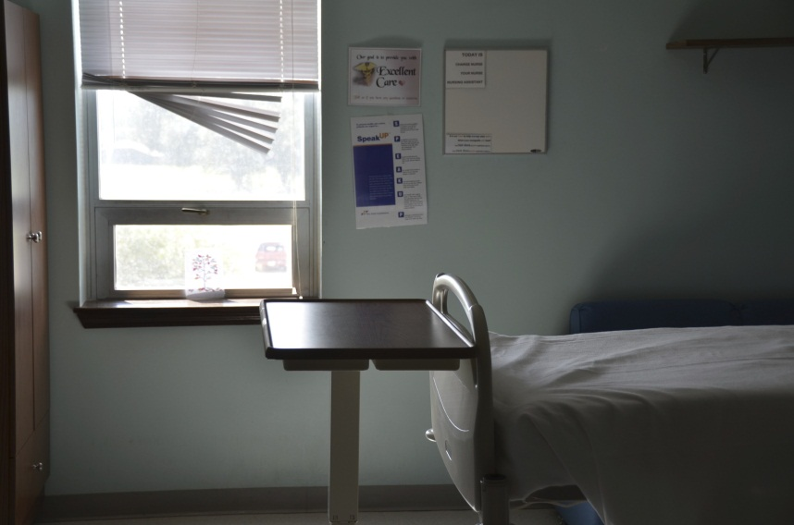
Reshaping lives for generations
Vision: Magellan will transform the landscape of behavioral health care delivery in Louisiana by providing an infrastructure that paves the road to Recovery, Resiliency, good health and happiness. Louisiana’s behavioral health system will be first in its class.

Slide 7
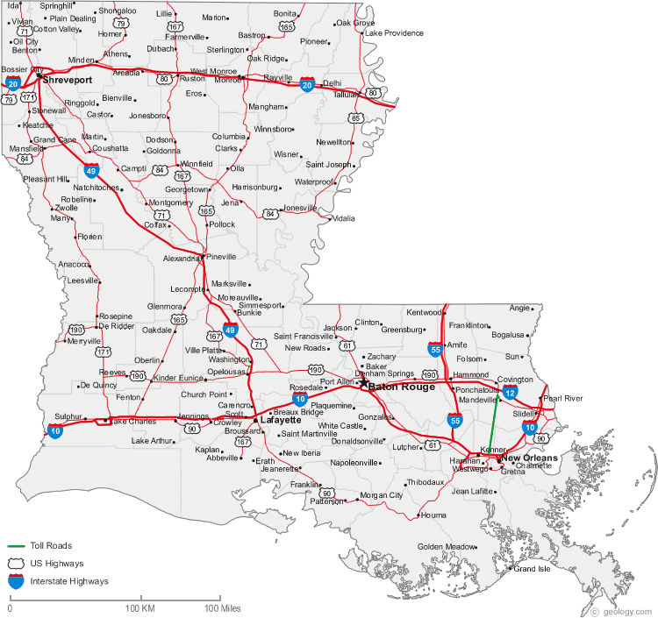
Meeting challenges head on
Meet people where they are: About 100,000 miles travelled across Louisiana
Ensure Continuity of Care: Priority No. 1
Address provider concerns
  Adjusted Care Management program to reduce wait times
  Train staff constantly on nuances of program
  Focus on eligibility
  More than 300 fixes or enhancement to Clinical Advisor

Slide 8
Clinical Outcomes
Transforming Care in Louisiana
Notes:
Bill
Our focus as a Managed Care Organization is laser-like on clinical outcomes. We use a lot of data to focus our coordination efforts and we want to share some of those results with you today.

Slide 9
Shifting the Paradigm
Notes:
Bill: The first year story is a very simple one in Louisiana. Our goal from day one is to make a reality of what people have been calling on for years. Reduce Inpatient utilization … (LISA TO TURN SLIDE)

Slide 10
Shifting the Paradigm
Notes:
Bill: And Increase Outpatient Utlization. We know that far too long people in our state have been stuck in a cycle of institionalization with few options for a way out and little help even where services existed. You expanded the services available, our job has been to make sure we’re able to step down and divert people into those services. This graph shows that happening.

Slide 11
Shifting the Paradigm
Notes:
Bill: Obviously, children are different than adults and our strategies and goals aren’t quite the same. While we want to see inpatient go down and we have seen at least a leveling here, what’s really important with children…

Slide 12
Shifting the Paradigm
Notes:
Bill: You see more children accessing more OP services. This is just one example of a Community Based Services. With the addition of CSoC, that adds another dimension and when we are fully managing Residential Services for DCFS and OJJ, we expect to see more shifting as we can step children down or divert them more effectively.

Slide 13
Examining access and recovery
Notes:
Bill --

Slide 14
Examining access and recovery
Notes:
Bill

Slide 15
Evidenced-Based Practices
Notes:
Bill: While we don’t have complete data on RCM, we know from the impact of our follow up program on our highest utilizers that we are having success. Here you see the top 32 utilizers identified in the first few months of operation. The orange lines represent the number of readmits these members had before 9-1. With intense case management and follow up, you can see how we were able to prevent readmissions for more than half of them after sept. 1 and drastically reduce it for others. These are very sick people, but with the right level of care, they are able to begin a path of recovery.

Slide 16
Moving people toward Recovery
Notes:
Bill: While we don’t have complete data on RCM, we know from the impact of our follow up program on our highest utilizers that we are having success. Here you see the top 32 utilizers identified in the first few months of operation. The orange lines represent the number of readmits these members had before 9-1. With intense case management and follow up, you can see how we were able to prevent readmissions for more than half of them after sept. 1 and drastically reduce it for others. These are very sick people, but with the right level of care, they are able to begin a path of recovery.

Slide 17
Increasing Access to Care
Improving access through
Network Development
Notes:
Shannon: A significant part of our program is the development of a stable and robust Network of providers. Even when we were developing our proposal, we knew this would be a evolving process. With the significant changes made to the Medicaid plan and additional changes we have made and will continue to make for the adults because we are capitated, we have focused our development efforts on the most critical areas of need as it relates to access to care.

Slide 18
Increasing Access: Building the Network
  Feb 28 vs. October 24 network composition
Inpatient psych beds increased by 86% across Louisiana due to contracts with free standing psych units for adults
Notes:
So this shows bed capacity. It’s always been important to us to have robust bed capacity. It helps us move people through and step them down to appropriate levels of care more quickly and is an important part of the crisis continuum which we will talk about more in a little while.

Slide 19
RFP Deliverables Strategy – Where are we now?
Notes:
Shannon

Slide 20
Where we are now
86% increase in psychiatric bed capacity
300 active provider locations using Clinical Advisor
251 provider locations contracted for Crisis Intervention service
183 new OMPTs brought in throughout the state all additional capacity that added since 3/1
  First two Licensed PRTF beds (108) in place
  Ongoing dialogue with several hospitals engaged in dialogue about expansion of services array to include PRTF
  TGH 8 beds licensed in the state- ongoing conversations to encourage programs to obtain licensure
  TFC 248 beds
  Non- medical group home 230 beds

Slide 21
Where we’re going: Network Plan
Identify network gaps using the following details:
  Readmission rates
  LOS
  Adverse Incidents
Develop and Submit RFP for:
  Crisis Continuum
    Crisis Receiving Centers
    Crisis Stabilization
    Crisis Residential
  Therapeutic Group Home
  Therapeutic Foster Care
  PRTF
  EBP
Notes:
Shannon

Slide 22
Where we’re going: Network Plan
Complete the Crisis System Build out in all regions
Mobile Crisis Services
CART Teams
23-hour Observation/Crisis Receiving Centers
Telehealth
Peer-run warm lines
Crisis Stabilization Services
Crisis Residential Services
Notes:
Evon

Slide 23
Where we’re going: Network Plan
Complete the crisis system build out in all regions- Strategies
Current Strategies To Date
  Identifying providers who could transition existing facility to new levels of care
  Direct outreach
  Direct support and direction with licensing, certification and contracting process
Strategies Under Consideration
  Email blasts to assess interest of current Network providers
  Educational webinars
  Regional Town Hall meetings to engage regional leaders and stakeholders
  Identify licensing, programmatic or financial barriers to any LOC development
Notes:
Shannon

Slide 24
Where we’re going: Network Plan
Expand Evidence Based Practice (EBP) capacity through learning and technical assistance
Partner with Medical Director to expand into EBP for 0-5 population
Partner with System Transformation to assess the need to expand existing EBP
MST (30 providers across the state)
FFT (7 providers across the state)
Homebuilders (10 providers across the state)
ACT (11 teams across the state)
Notes:
Evon

Slide 25
Provider Relations Plan
Developing plan to include the three overarching goals
  Enhanced Provider Communication
    Provider Relations Network team re-structure
    Utilization of E-mail blast notification
    Timely Provider Communications
    Partnership Provider News
    Provider Website/Increase Provider Self Service
    Timely Telephonic Communication
  Enhanced Collaboration with Providers
    Provider Meetings and Combined Stakeholder Meetings
    Provider Satisfaction Surveys
  Enhanced Provider Education
    Webinar Provider Forums
    Provider Relations / On-Site Visits
    New and Contracted Provider Orientation and Training
Notes:
Shannon

Slide 26
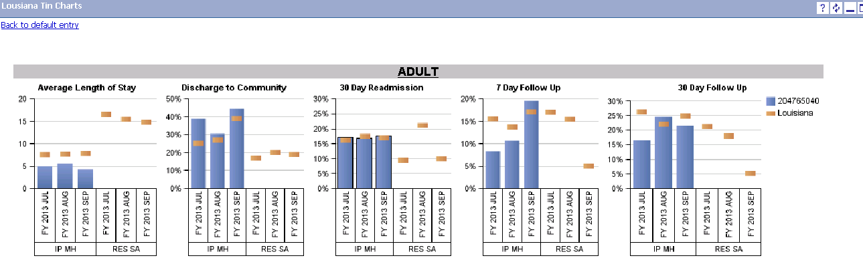
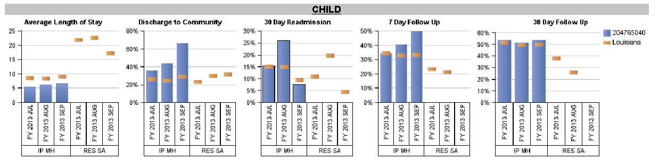
Provider Dashboard – Monthly Drill Down
What are they?
Fully interactive online data management platform for providers, with drill down capability
Easy to use, visual representation of data
The same outcome measures which help to guide decisions on the evolution of the LBHP network
On-line data management platform
Why do we offer them?
Provider self-management
Use of data to inform quality
Transparency
Partnership
Tool to aid in program improvement, benchmarking, and other QI management strategies
Notes:
This is a sample of a report they will get on the dashboard. I know it’s hard to read, but you can see where the Louisiana averages are for say Average Length of Stay in the bottom left corner and where this provider is.

Slide 27
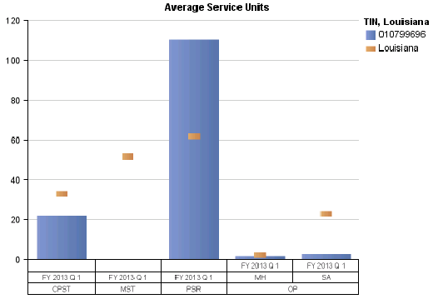
Provider Dashboard – Phase 2
Rolled out Phase 2 with training to providers on March 21
Providers included:
Outpatient Mental Health
Outpatient Addictions Treatment
Psychiatric Rehabilitation
Community Psychiatric Supportive Treatment, including Homebuilders
Multisystemic Therapy
Metrics include:
Number served
Number served by diagnostic category
Average number of services per member
Notes:
Louisiana Provider Dashboard
The Louisiana Provider Dashboard is a web based electronic dashboard that allows approved providers in the Magellan care network to access their data on a continuous basis. Each provider has access only to his/her data and the aggregate data from the remainder of the providers at the same level of care. The dashboard first roll out occurred on November 30, 2012, and it focused on metrics associated with inpatient mental health facilities and substance use residential facilities. The metrics include average length of stay, referral to the community, thirty day readmission rates, seven day follow up rates, and thirty day follow-up rates. Each provider may access the dashboard through Magellanprovider.com (http://Magellanprovider.com). The dashboards are available for mental health inpatient, substance use residential providers, Psychosocial Rehabilitation (PSR) providers, Community Psychiatric Support and Treatment services (CPST), Multisystemic Therapy (MST), and clinic based mental health and addiction services. The second dashboard roll out occurred on March 6, 2012 and a webinar was conducted the morning of March 21 with over 80 providers. An additional webinar was presented to OBH staff that afternoon. The second roll out metrics focus on community based programs and provide data on number served, number served by diagnostic category, and average number of services per member by provider. The data can also be viewed in graph format. The final planned roll out will occur prior to the end of the second quarter of this year and will enhance the current dashboard with drill through capability so that providers may see individual member data if needed.

Slide 28
Provider Quality Improvement Projects
PCP Coordination: The item with the lowest compliance is coordination of care with PCP. The current compliance rate across all levels of care is 31.2%. The QI department is currently working on a system wide Performance Improvement Project with PCP coordination. This project is still in its pilot phase and rollout is expected within the 2nd-3rd quarters.
Discharge Process/Planning: Discharge planning was also identified as an opportunity for improvement by UM to improve their 7 and 30 day follow-up hospitalization rates and items and QI to address deficiencies identified through the TRR process. The total discharge aggregate is currently 84.7%; however, outpatient facilities have an aggregate score of 51.5% and WAAs have an aggregate of 40%. QI will be collaborating with UM’s Follow-up Hospitalization QIP to improve the discharge process to ensure member’s receive adequate care following discharge. This QIP is in the analyze stage.
A new TRR audit tool under development will have a weighted component to support these two initiatives.
Notes:
Neal

Slide 29
The numbers
Claims

Slide 30
Claims
Notes:
Lisa

Slide 31
Looking ahead
Year 2 and refining the program

Slide 32
Strategy for Year 2
Fully implement 0-5 programs
Expand crisis network
Expand children’s network (PRTF; therapeutic group homes)
Use data to drive additional service opportunities through “in lieu of” agreements
Outreach to non-traditional referral sources, such as PCP community and law enforcement
Focus on PCP, BAYOU HEALTH coordination of care
Work toward Meaningful Use in CA
Improve reach and focus of RCM program, emphasizing diagnostically-driven criteria
Drive improvements in discharge planning
Drive change in crisis response away from ERs and PECs to better use of community programs

